Slide 1




Coding Summer School
Notes:
Welcome
Teacher’s presentation

Slide 2

What is coding?
Notes:
Brainstorming

Slide 3

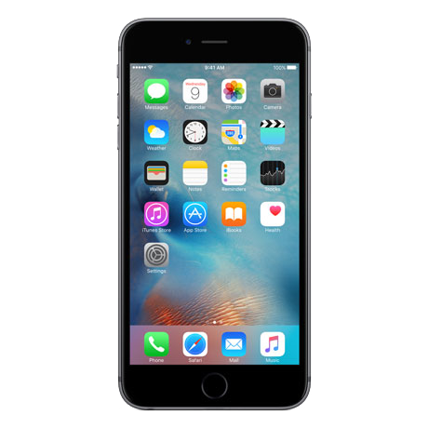
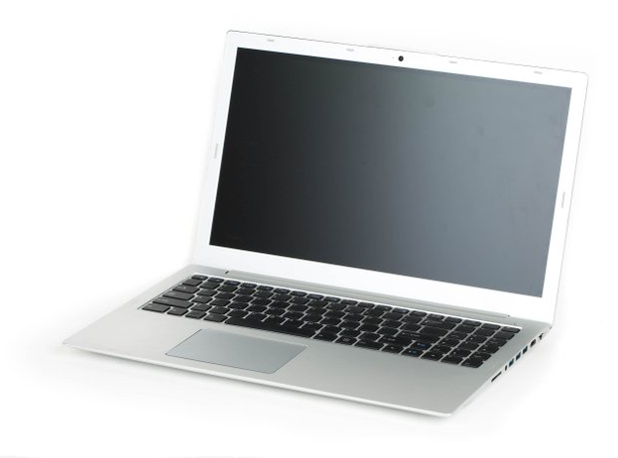


Notes:
Mostknow internet webs -> code background

Slide 4




Notes:
Not online that… -> this things are also coded, beacause they do things as they have been programmed to

Slide 5

Notes:
How do coding works?
Instructions – like a recipe, that need to be precise.
These instructions are interpreted by computers and follow them.

Slide 6
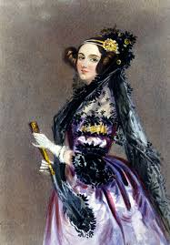
1815
Ada Lovelace
Notes:
The mother of coding is from 1815!!

Slide 7
How you will use code?
Notes:
What do you want to code?
Things that you think will be good to code
Future

Slide 8
Let’s play!
Notes:
What do you want to code?
Future

